Slide 1
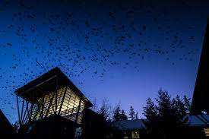

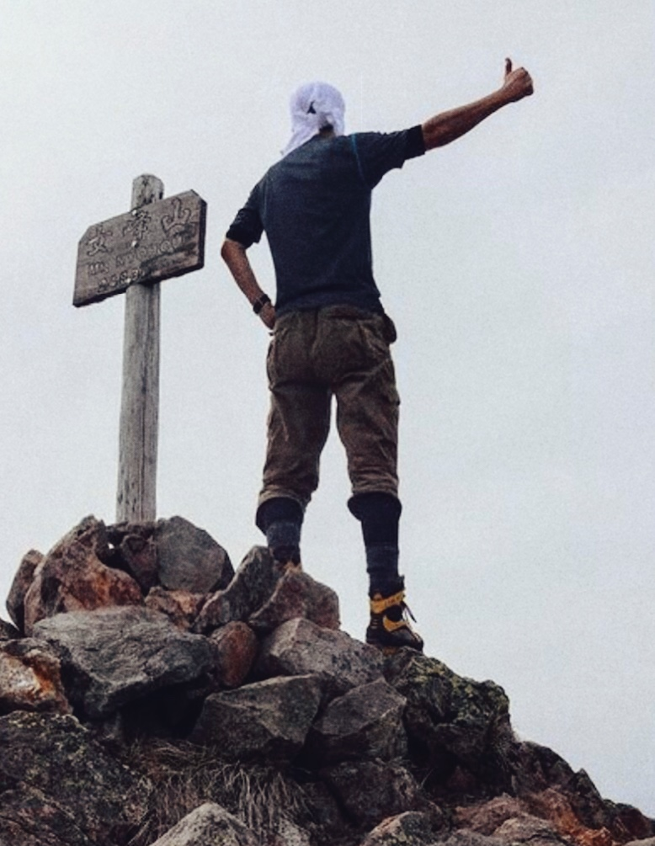

Sequence typing and source tracking of crow (Corvidae) Campylobacter isolates from Washington wetlands and Kolkata, India: Is there a difference in their origins?
https://www.washington.edu/news/2017/12/05/rooftop-wiretap-aims-to-learn-what-crows-gossip-about-at-dusk/
Megavarsha Subramani
Major: Biology
Minor: Diversity Studies
Elena Nguyen
Major: Biology
Henry Van Vuitton
Major: Biology
Minor: Neuroscience

